Slide 1
HNDIT11062 – Web Development
Week 1: Introduction

Slide 2
Module Code | HNDIT11062 |  | Module Title | Web Development
Credits | 2 |  |  | Lectures | 01
 |  |  | Hours
GPA/NGPA |  | GPA |  | Lab/Tutorial | 03
Semester |  | S1 | Module Type | Core compulsory

Slide 3
Module Objective
To develop skills required for using Internet and software tools associated with the Internet for information search, retrieval, and networking for improving productivity at work
To develop skills and knowledge required for development and deployment of simple websites with static content

Slide 4
Learning Outcomes
At the end of the module the student will be able to
  Describe the history and the development of the Internet
  Describe operation and governance in the Internet
  Connect a computer to the Internet using different connection options
  Use common Internet based applications such as WWW, email, FTP etc.
  Describe and use emerging applications and social networking tools (Face Book, YouTube, Twitter etc.)
  Apply necessary security measures for transaction over the Internet
  Understand and describe the concepts of web design, basic HTML and related web technologies
  Use a website development software applications to design and develop simple websites with static content
  Deploy simple websites on server

Slide 5
Outline Syllabus
History and development of the Internet
How Internet operates and Internet governance
Different ways of connecting to the Internet
Common Internet based applications (WWW, email, FTP etc.)
Types of web-sites (Static, Dynamic, Collaborative and Syndication etc.)
Migration from Web 1.0 to Web 2.0 and the differences between them
Modern Web applications (Social Networking, e-Commerce, e-Governance)
Data security issues in Internet (Viruses, Adware & Spyware, Trojan programs etc.)
Protecting data in the Internet

Slide 6
Outline Syllabus (Cont.)
Introduction to World Wide Web and web technologies
Markup languages – HTML basics
Use of styles and frames
Website development using a design tool
Deploying websites

Slide 7
Assessment and Weighting
Assignments and tutorials 50%
Structured Paper 50%

Slide 8

Introduction

Slide 9
We all use the Internet, but what is it?
A network of computer networks
A descendent of Cold War defense technology
The most powerful distribution system in the history of civilization
A medium that melds text, audio and video through digitalization.

Slide 10
Internet
The Internet is a group of computer networks interconnected around the world.
It is the largest communication network ever conceived.
The connected networks are comprised of educational, commercial and government sites.
The interconnected networks may be made up of any number of computers from two to infinity.
The collection of sites residing on the Internet form one of the largest repositories of information in history.

Slide 11
Computer Network
A computer network, often simply referred to as a network, is a collection of computers and devices interconnected by communications channels that facilitate communications among users and allows users to share resources.

Slide 12
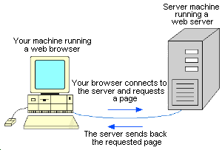
How it works

Slide 13
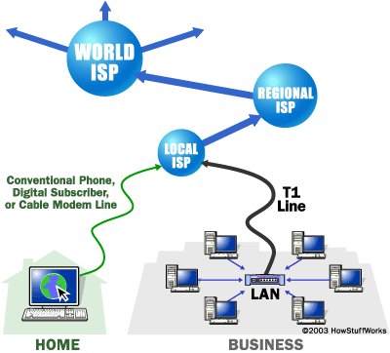
How Internet structured

Slide 14
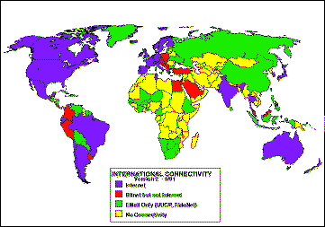
World Internet Presence, 1991

Slide 15
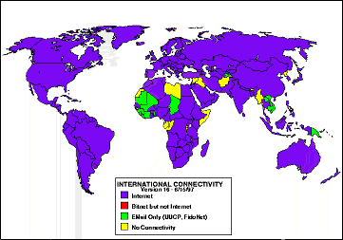
World Internet Presence, 1997

Slide 16
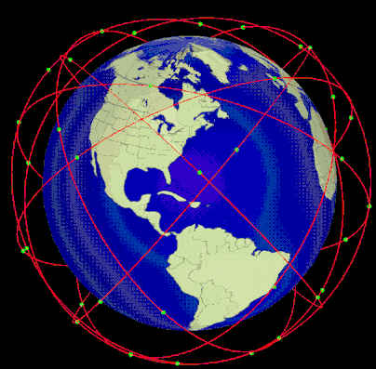
Global cyberspace connections are made by satellites…

Slide 17
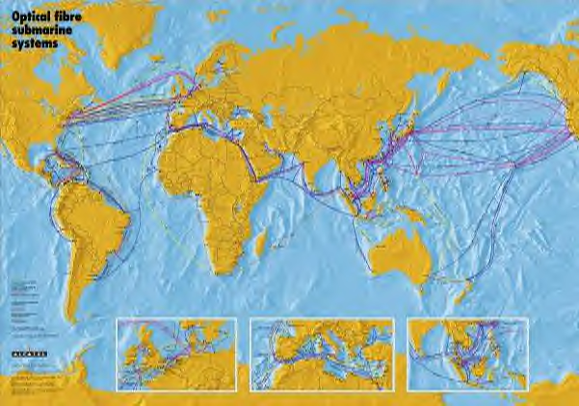
Or undersea cables…

Slide 18
Evolution of the Internet
1820s—First experiments in building calculating “engines” done by Charles Babbage.
1890—Herman Hollerith develops digital processing machine to compile U.S. Census.
1944—IBM builds electromechanical calculator to help calculate trajectories for weaponry and to break German and Japanese codes.

Slide 19

1957—Soviet Union ratchets up Cold War by launching first orbiting man-made satellite, Sputnik. U.S.
Defense Department creates ARPA (Advanced Research Projects Agency) to apply technology to Cold War defense.
1961—IBM designs computer system that allows separate terminals to access same hardware, effectively inventing “remote access.”

Slide 20
1969—ARPANET computer network started. The network makes use of a packet-switching concept that would send messages in pieces and assemble them at their destination. Thus, no one path destroyed by nuclear attack could disable a message.

Slide 21
1972—At the First International Conference on Computers and Communication, ARPA scientists demonstrated their network, linking computers between 40 different locations.
First email sent between research facilities.

Slide 22
1974—Scientists at ARPA create a common language that allows different networks to communicate. It’s called transmission control protocol/internet protocol (TCP/IP).
Other computer networks are devised:
    Telenet (1974—commercial version of ARPANET)
    Usenet (1979—focusing on email and newsgroups)
    Bitnet (1981—links scientists across disciplines)

Slide 23
1976—Queen Elizabeth sends an email from Buckingham Palace.
1983—ARPANET abandoned by government for military research functions.

Slide 24
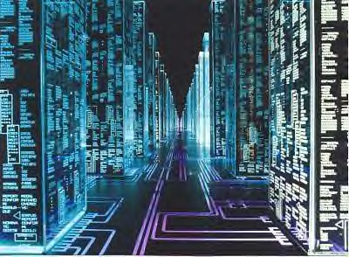
1984—William Gibson, a novelist, coins term “cyberspace,” using it in his sci-fi book Neuromancer.

Slide 25
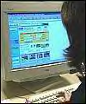
1984—Domain name servers introduced (.com, .gov, .org, .edu), making Internet addresses easier to remember.
1985—NSFNet founded, which creates the Internet “backbone” (massive high-speed network pathways)

Slide 26

1985—San Francisco network the WELL (Whole Earth ‘Lectronic Link) starts up as one of the first bulletin boards and chat sites.

Slide 27
Effects of NSFNet
Allowed increased Internet capacity.
Encouraged surge in Internet use. (By 1986, host computers numbered 5,000. In 1987, there were 28,000 hosts.)
Encouraged private Internet providers because commercial enterprises were excluded from NSFNet.

Slide 28
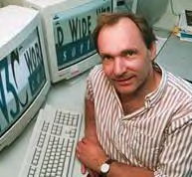
1989—CERN scientist Tim Berners-Lee designs World Wide Web as a way to share and retrieve research. He designs first browser and HTML.
1990—Internet hosts number 300,000.
First “search engine,” called Archie,
developed at McGill University, Montreal.
1991—NSF removes its restriction on private access to its backbone computers, a result of the end of the Cold War.

Slide 29
1991—Sen. Al Gore sponsors High Performance Computing Act, which funds research into improving the Internet infrastructure.
1992—Only 50 Websites exist in the world.
1993—Mark Andreessen invents Mosaic browser, which would lead to his company Netscape. His browser allows easier “surfing” of the Web.

Slide 30
1994—Proprietary computer services, such as Prodigy, Compuserve and AOL, provide Internet “gateways” for their subscribers.
1995—25,000 Web sites exist.
1996—More than 250,000 Web sites exist.
1997—E-Commerce gets underway and the start of .com retailers, such as Amazon.com.

Slide 31
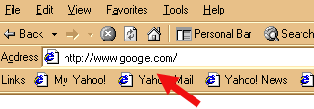
2005—Google.com can search more than 8 billion Web pages.

Slide 32
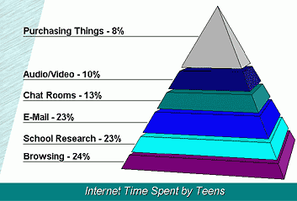
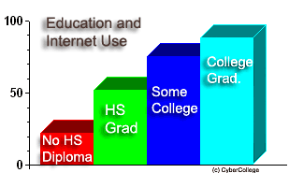

Slide 33

Where will the Internet take us?
All traditional media will use the Web for distribution. Some mainstream media, such as newspapers, may end up moving totally to Cyberspace.”
Movies, books, music, TV will be increasingly downloadable from the Internet onto storage media, such as today’s DVDs.
The Internet will likely be as accessible as our phone network, as we use it from our cars, from pocket devices and from devices yet to be imagined. (Instead of taking our cars in for recall repairs, might patches downloadable from the Internet fix electronic components or monitor maintenance?)

Slide 34

As more bandwidth becomes available, graphics and video will be the norm and text will take a backseat in presentation of content.
The voice of the individual among the world’s billions of human beings will be discernable.
Global, instantaneous distribution of information and culture will further “shrink” and homogenize the planet, making us a true “Global Village.”
The Internet will be ubiquitous, available everywhere wirelessly, like cell phone service.

